Slide 1

Health Insurance Management System

Slide 2





Team Members
Yeswanth Chamarthy
Saranya Chintalapati
Hareesh Prathipati
Sudheshna
Mullaguri
Poojitha Thaduri

Slide 3



Objective
To create a database system that helps both customers and admins to manage the health insurance data.
Maintaining the insurance company's data records.
Maintaining data records about new and existing policies.
Maintaining data records for the agents.
To manage data records of corporate clients.
To keep track of customer data.
To maintain data records of the insurance claim.
To manage patients' treatment records.
To keep track of the bills that have been created.

Slide 4

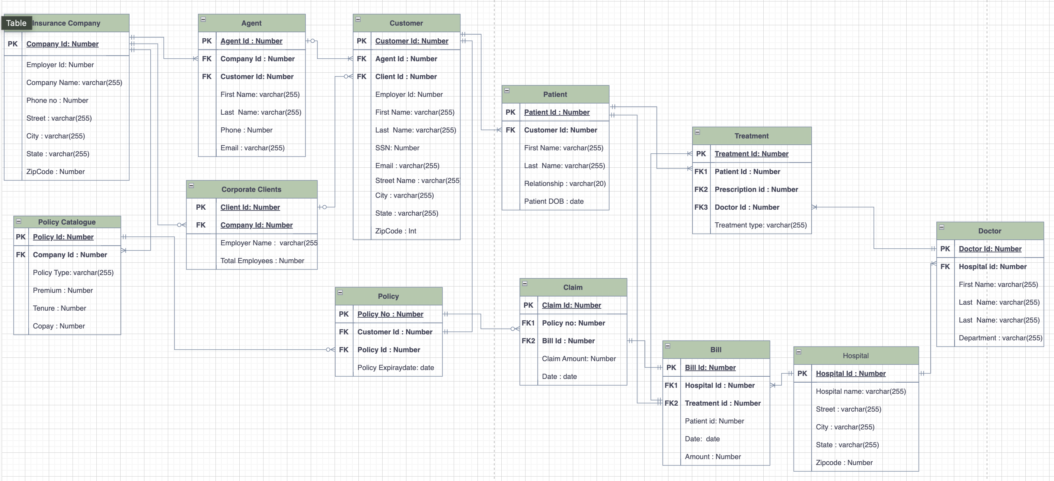
ER Diagram

Slide 5

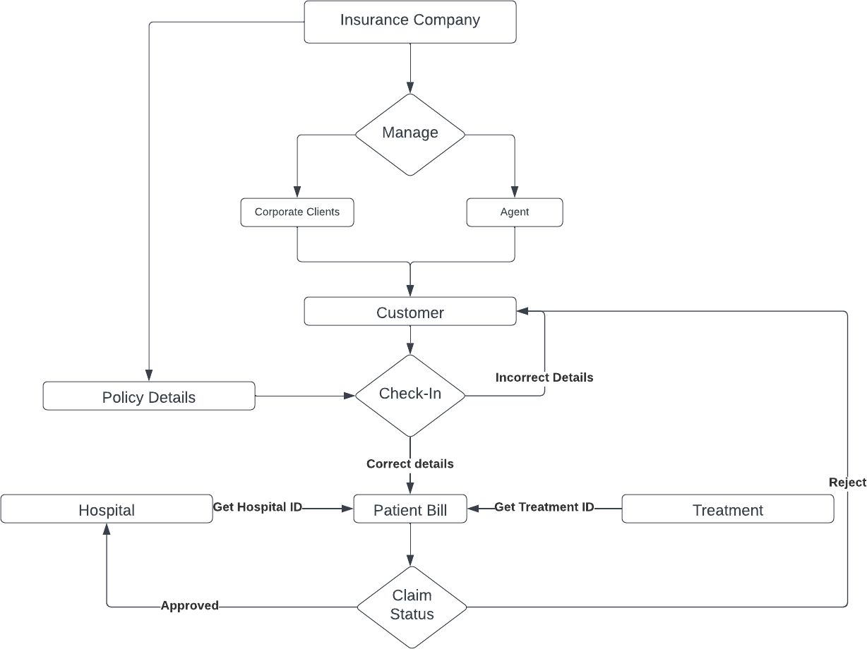
Project analysis slide 2
Data Flow Diagram
Health Insurance Management System:

Slide 6
Views
Views in Oracle are virtual tables that don't physically exist.
It is stored in the Oracle data dictionary and doesn't keep any data. It can be executed when called.
The following views are created to meet the objectives of the project.
select * from PatientPerDoctor;
select * from claimstatus;
SELECT * FROM ALLPOLICIES;
SELECT * FROM CORPORATECLIENTS;
SELECT * FROM AGENTDATA;
SELECT * FROM CUSTOMERDATA;
SELECT * FROM CLAIMRANK;

Slide 7
Views Created:
To display patient per doctor
To display claim ranking
To display all customer data
To display all agent data
To display insurance companay
To display all corporate client data

Slide 8
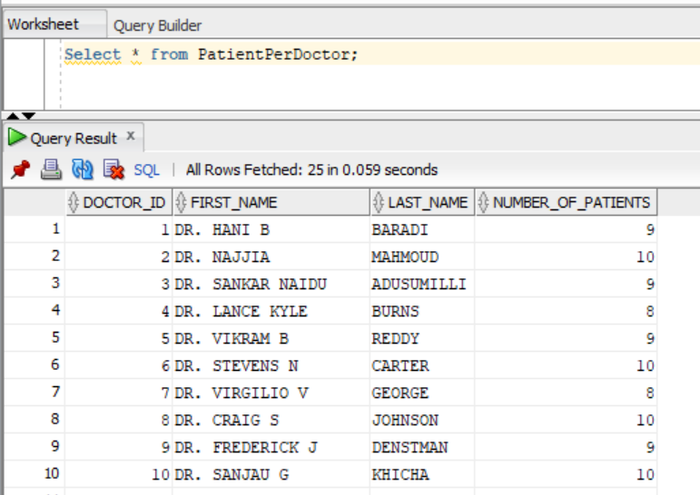
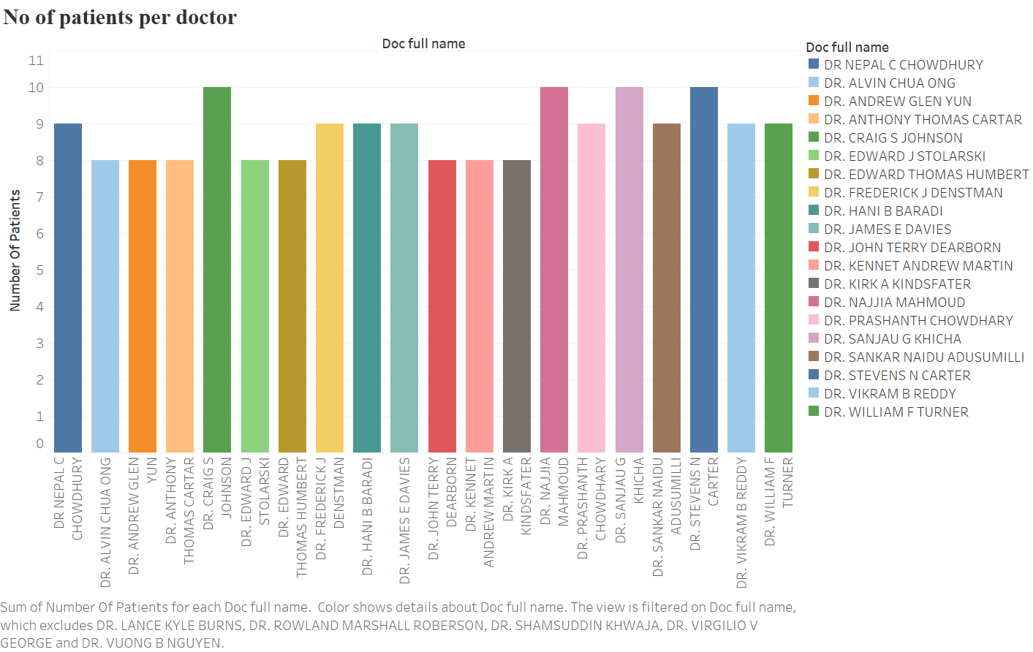
View for the patient per doctor
Display the total count of the patient for the doctor.

Slide 9
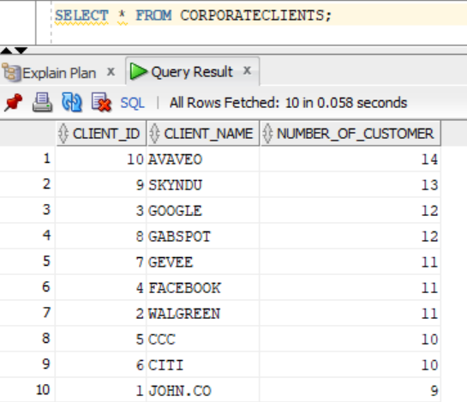
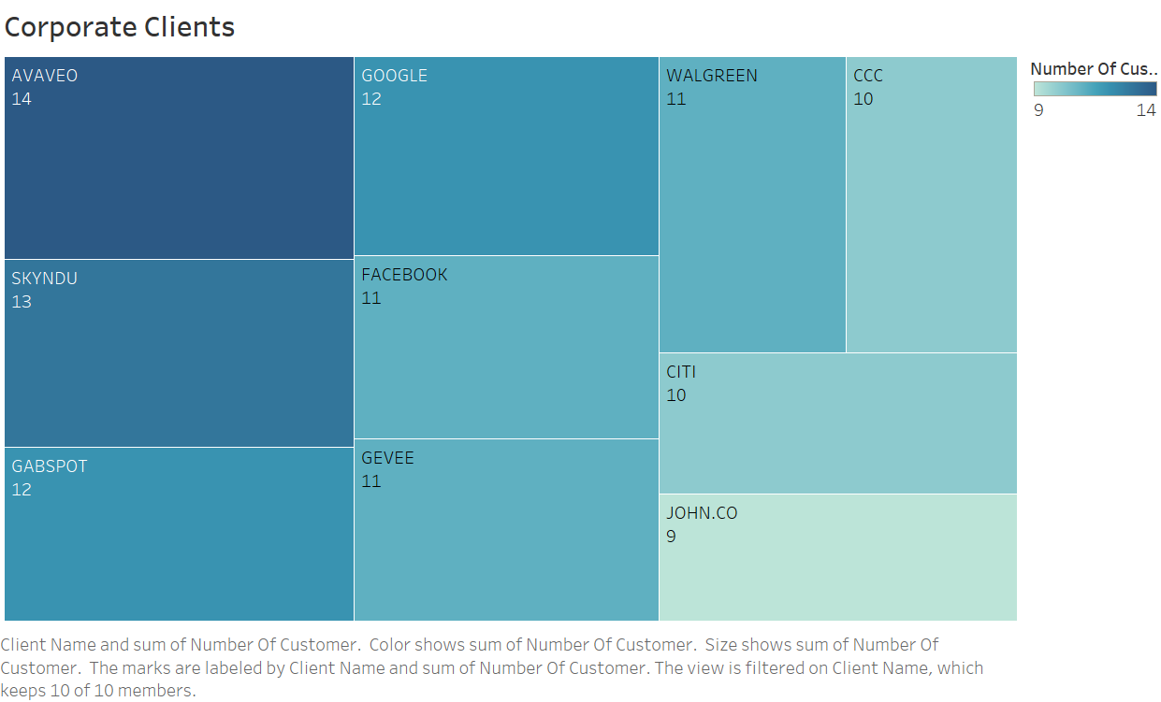
View for Insurance Companies for the total number of customers from Corporate Clients
Track details of Customers from each Corporate Client
Display Corporate Clients with the highest number of insurances purchased.

Slide 10
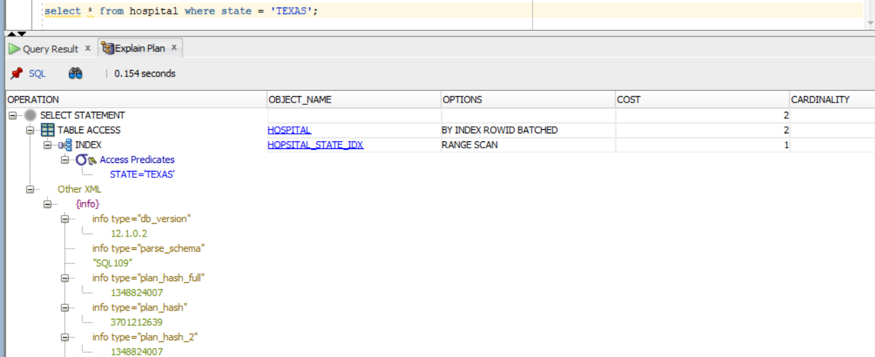
Optimizing Query Performance
Index is created on the state column of hospital table and a bitmap index is created on the claim status of claim table. Indexes are used to retrieve data from the database more quickly than otherwise.
select * from hospital where state = 'TEXAS’;
Instead of a FULL scan, a RANGE scan is performed on the data and the cost reduced to 2 units. Thus, improving the query performance significantly.

Slide 11







